Slide 1
Wave Speed

Slide 2
When you have completed this lesson you should be able to:
Describe the relationship between period, frequency, wavelength and speed.
Solve problems involving the period, frequency, wavelength and speed of a wave.

Slide 3
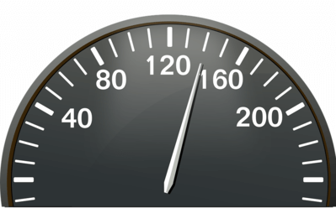
There is one remaining property of waves that we have yet to discuss; wave speed.
Every wave propagates at a certain speed. This is the rate at which the wave covers distance. It has the symbol v and units of metres per second (ms⁻¹). The speed of a wave remains constant while travelling in the same medium.

Slide 4
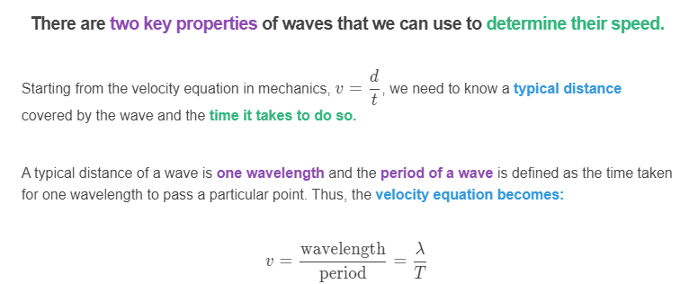

Slide 5
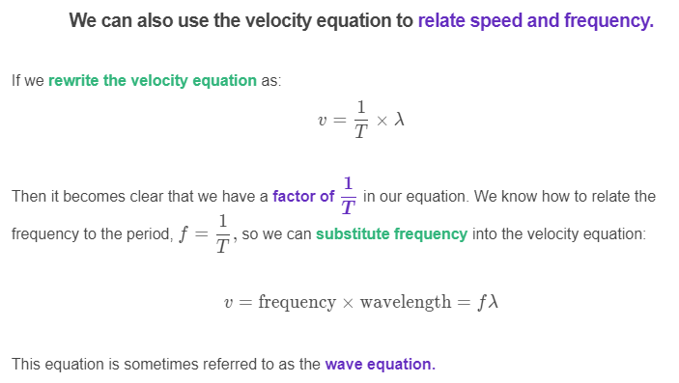

Slide 6
An alternative method of obtaining the wave equation is using the units of each parameter.
The speed of the wave has units ms⁻¹. We know the wavelength of a wave has units m so we need to find a parameter that has units s⁻¹ to multiply with in order to obtain units of ms⁻¹.
Frequency has units of Hz but can also be measured in units of s⁻¹, therefore if we multiply frequency and wavelength we get the units for speed and therefore must obtain the speed of a wave.
Although amplitude also has units of metres, m, it cannot be used to determine the speed of the wave as the distance covered by the amplitude is perpendicular to the motion of the wave.

Slide 7
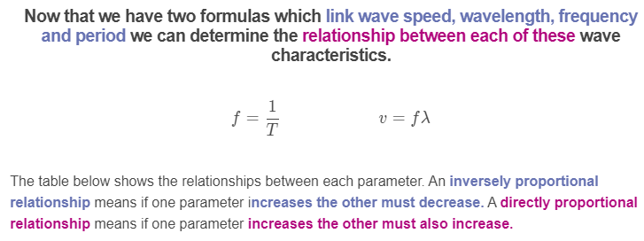

Slide 8
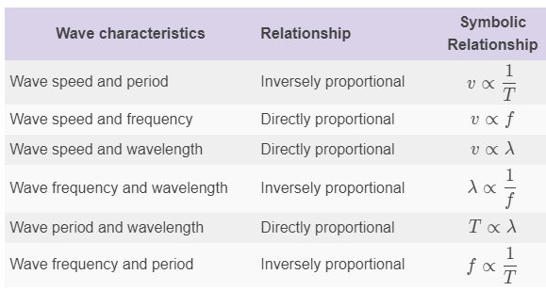

Slide 9
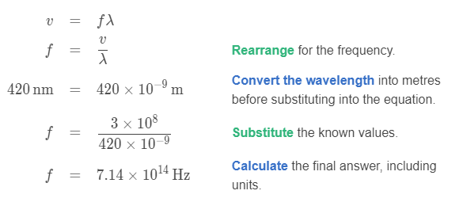
Let's work through an example of using the wave equation to determine the frequency of a wave.
In a classroom experiment a laser has been set up. It is emitting light with a wavelength of 420nm. The speed of light is 3×10⁸ms⁻¹. Calculate the frequency of this light.
We will use the wave equation to solve this problem, but we will need to rearrange it for the frequency of light.

